Slide 1
Panda Catcher

Slide 2
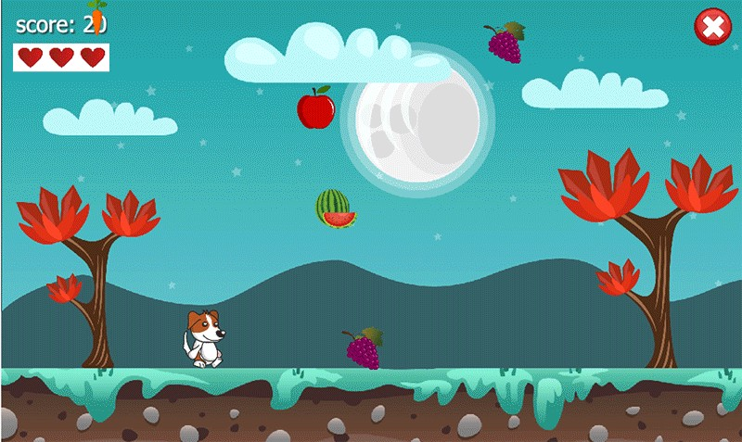
Elevator pitch
You play as a panda that is catching food for himself.
The objective of the game is to catch as much food as possible.
Without dropping any of the food on the ground.
Example game >

Slide 3

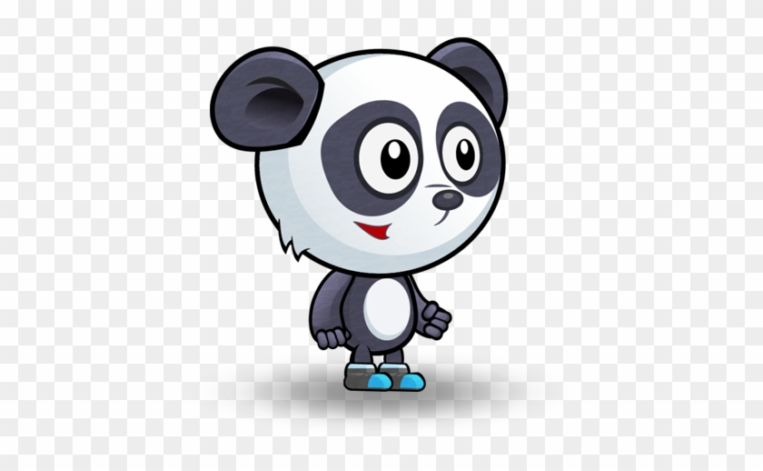


30 seconds gameplay description
The game will feature the player as a panda who will catch bamboo to eat.
But some people decided to throw trash at him, avoid the trash and catch bamboo to eat.
Go trough levels and unlock cosmetics and more levels. The higher level you get to, the harder it gets!

